Slide 1
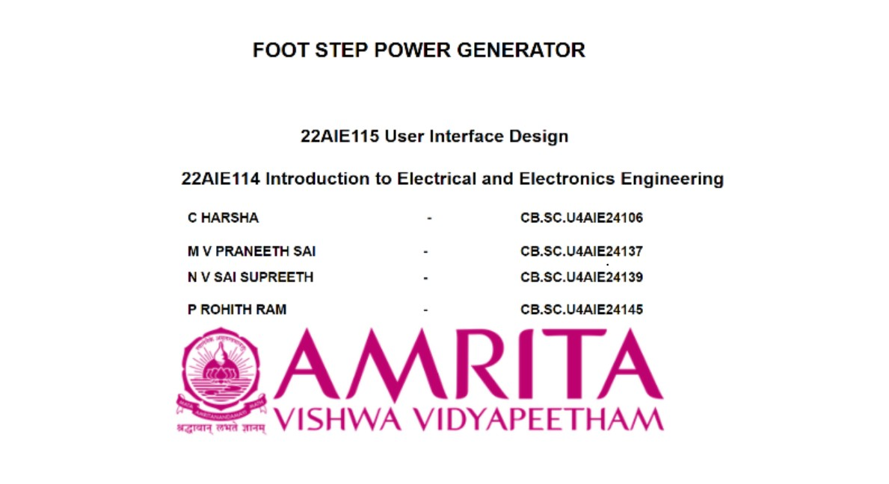

Slide 2
FOOT STEP POWER GENERATOR

Slide 3
INTRODUCTION
Footstep Power Generator is a project that turns our steps into electrical energy using piezoelectric discs.
It will display us how much power generated and how many times we stepped on it.
The mechanical energy generated from footsteps is converted into electrical energy.
This energy can be stored or used to power small devices.

Slide 4
WORKING PRINCIPLE
piezoelectric effect

Slide 5
Piezoelectric effect : It is a unique property of certain materials (like crystals, ceramics, or specific polymers) that allows them to generate an electric charge when mechanical stress or pressure is applied to them
How it is used in our project ?
The footstep power generator counts the steps by detecting pressure applied on
the piezoelectric discs. Every time when we step on the platform the disc generate
a small voltage signal. The Arduino reads these signals counts them as steps , and
displays the total number on the screen.

Slide 6
PROBLEM STATEMENT
As the demand for energy is increasing rapidly and natural energy resources like fossil fuel
diminishing and contributing to environmental pollution .in many public spaces like train
stations ,shopping malls and gym many peoples walk and the energy generated by the
steps are being wasted .
SOLUTION
The solution for this problem is using Foot step power generator in such crowded places
such that the power generated by the steps of the people can be stored and used to
power small devices and lighting systems

Slide 7
S.NO | TITLE | YEAR | METHODOLOGY | KEY CONTRIBUTION
1. | Piezoelectric Based Power Generation For Portable Charging System | 2023 | In this paper they utilizes the piezoelectric effect to convert mechanical pressure from footsteps into electrical energy, by connecting the piezoelectric sensors in parallel and the rectifiers and capacitors for efficient energy harvesting and storage. | The study demonstrates a practical implementation of footstep-based power generation, simulates the system using MATLAB, and evaluates its feasibility in high-footfall areas for sustainable energy harvesting.
2. | Piezoelectric Energy Harvest for Wearable Devices | 2022 | In this paper they used PVDF piezoelectric film , bridge rectifier, and a voltage regulator for energy harvesting from upper limb movements to power wearable medical devices. | This study found that the wrist is the best place to collect energy because it produces a lot of power. This helped to create special wristbands that power themselves using movement, which could be useful for health devices in the future!

Slide 8
COMPONENTS USED :
Piezoelectric disc
Arduino uno
10uf capacitors
1N4007 diodes
BC547 transistor
Resistors
LCD i2c display
18650 cell holder and cells
Led strip

Slide 9
METHODOLOGY
When a person steps on the acrylic sheet , some pressure is applied on the piezo electric discs.
This piezo electric discs convert this mechanical pressure into small electrical voltage which is called as piezoelectric effect.
The generated voltage is passed through diodes and capacitors for rectification , then it is stored in 18650 lithium-ion cells.
The Arduino Uno reads the voltage and displays it on an LCD I2C screen amount of power generated by the step.
The stored energy can be used to power LED strips and other small electronic devices
It is easy method to harvest footstep energy and convert it into electrical energy.

Slide 10
Real life implementation
Smart Footpaths & Pavements
These are installed in crowded places ,busy streets and on the steps of busy shopping malls .the generated electricity is used in many ways (like for streetlights, traffic signals, and public charging stations)
Sports Stadiums & Gyms
Installed in stadium floors or gym treadmills to generate electricity from player movements and running tracks.
Shoes with piezoelectric disc
Inserting piezoelectric discs in shoe soles to generate power while walking this energy can be used to charge mobile phones, smartwatches, or medical devices mainly useful to mountain climbers and hikers

Slide 11
CONCLUSION
Hence footstep power generator is a very efficient and eco friendly method to convert the mechanical energy into electrical energy. piezo electric effect plays a key role in this project and finally energy which is being wasted can be harvested with this the harvested energy can be used in different ways in different places and Further improvements can be made by combining it with various methods and technologies to improve energy harvesting."

Slide 12
FUTURE SCOPE
We can make it more efficient by using improved materials and store energy in more effective ways. By introducing Smart technologies like IoT and AI to it we can track and manage the power.
We can make it more effective by introducing wireless charging to it so that the stored energy from shoes or floors to directly charge devices without cables
This can work together with solar panels and wind turbines by storing all the generated energy in a common battery and we can use this stored energy in different ways

Slide 13
REFERENCES
Piezoelectric Energy Harvest for Wearable Devices | IEEE Conference Publication | IEEE Xplore
Piezoelectric Based Power Generation For Portable Charging System | IEEE Conference Publication | IEEE Xplore
https://youtu.be/YZ4OBxyyqOg?si=PlaiS7aDfRq7t1_Y

Slide 14
Thank you

